Slide 1




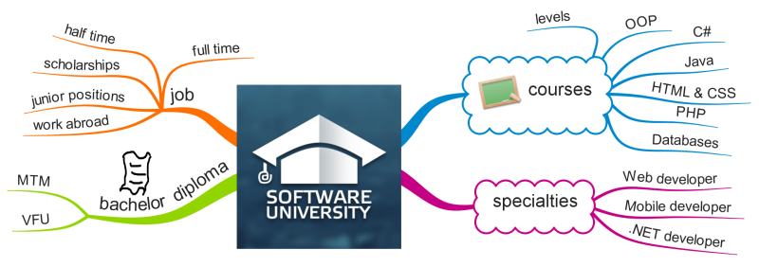
Mind Mapping
Visually Outline Ideas, Take Notes Efficiently, Summarize Information, Improve Memorization
Teamwork and
Personal Skills
SoftUni Team
Technical Trainers
Software University
http://softuni.bg

Slide 2

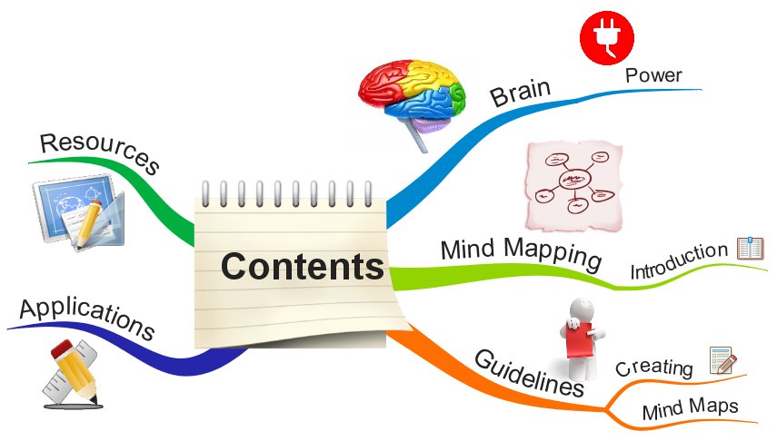
Table of Contents
The Power of Human Brain
Mind Mapping – Introduction
Creating Mind Maps – Guidelines
Applications of Mind Mapping
Resources

Slide 3

The Power of Human Brain
The Left and Right Hemisphere

Slide 4

The Power of Human Brain
The human brain has ~ 100 billion neurons
Each connected to 7 000 other neurons
Totally 100 trillion (10¹⁴) synapses
Basic brain functions:
Information processing
Perception
Motor control
Arousal (sleep / wake)
Homeostasis
Motivation & instincts
Learning and memory
Sources: http://en.wikipedia.org/wiki/Neuron, http://en.wikipedia.org/wiki/Brain#Functions

Slide 5
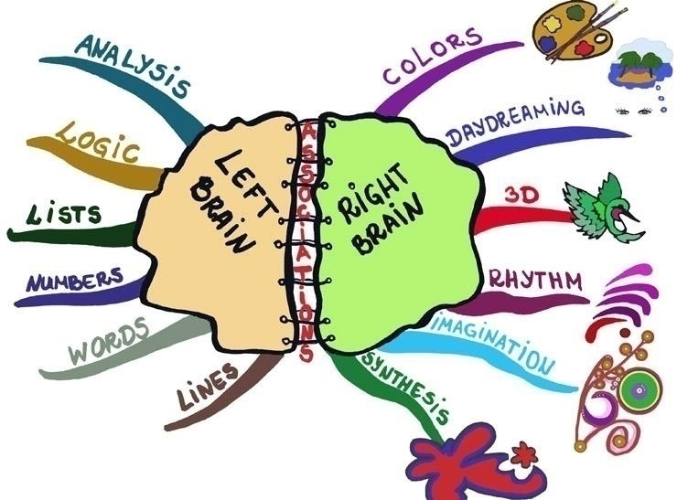
Human Brain: Two Hemispheres
Source: http://www.grammarmindmaps.com/about-mind-maps

Slide 6
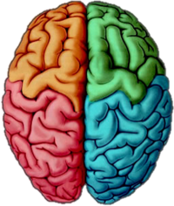
Left and Right Brain Combined
The true power of the brain comes when
The left and the right hemispheres are combined to work together
The mind operates many times better
How to combine the left and right brain hemispheres?
Use numbers and colors together
Use logic and imagination together
Combine spatial perception and hierarchy
Use mind mapping

Slide 7

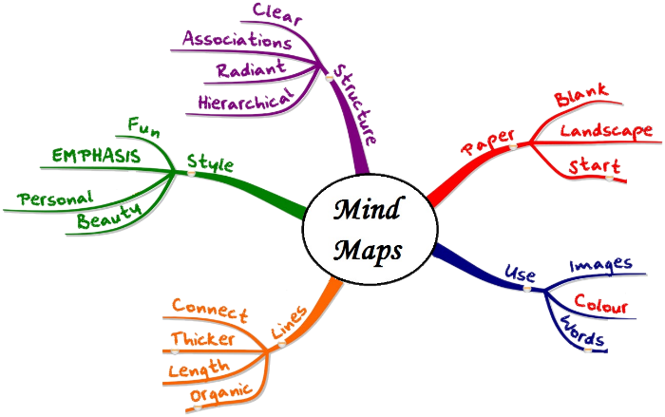
Mind Mapping
Introduction

Slide 8
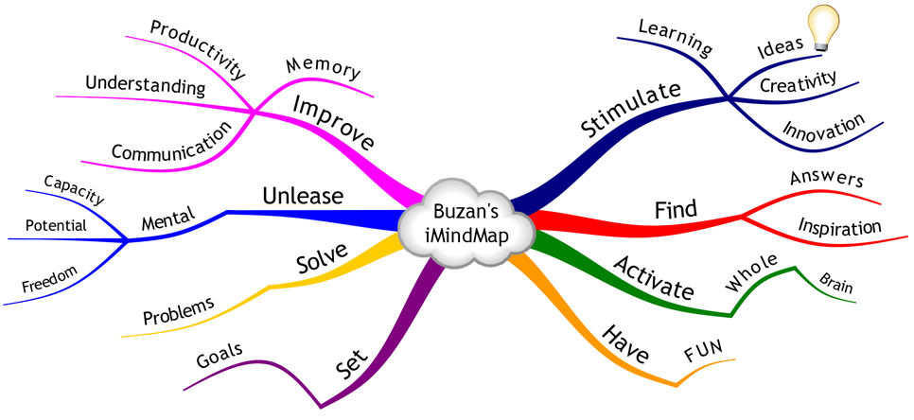
What is a Mind Map?
A mind map is a diagram used to visually outline information
Single concept (idea) in its center
Related concepts connected to the central idea

Slide 9
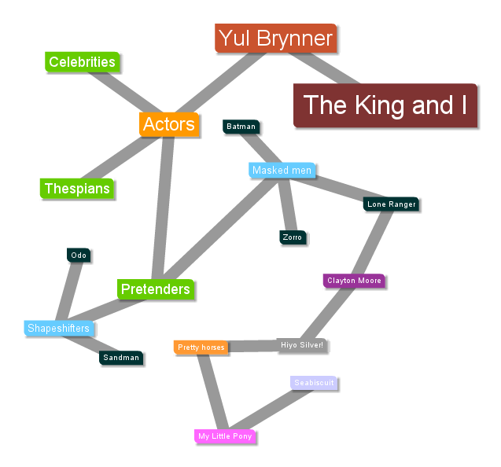
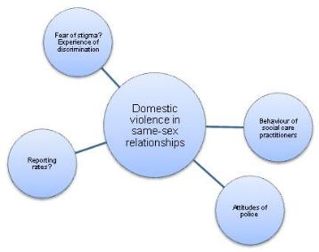

Mind Maps: History
Visualizing information through branching has old history
Trees, graphs, radial maps and other visual hierarchies are being used for centuries
Used in learning, memory, brainstorming, visual thinking, problem solving, etc.
Used by educators, engineers, psychologists and others

Slide 10


Mind Maps: Tony Buzan
The modern mind mapping is popularized by Tony Buzan
Famous educational consultant from U.K.
Author of 100+ books
Popular psychology author
Expert in brain development, mnemonic systems, creativity, speed reading and efficient learning

Slide 11
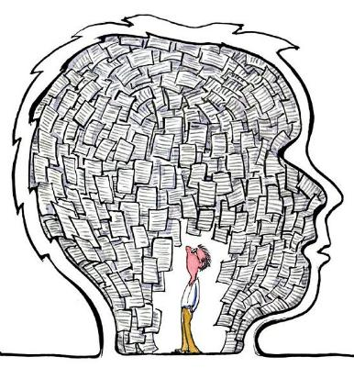
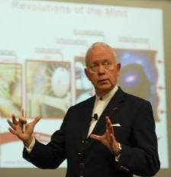
The Power of Mind Mapping
Wise people say
A picture is worth a 1000 words
Tony Buzan says
Did you know that you use less than 1% of your brain?
The good news is that mind mapping can access the other 99%
Mind mapping will greatly enhance your left and right brain cognitive skills
Mind maps will change your life

Slide 12

Examples of Mind Maps
Source: http://lor.sccsc.edu/lr/teachingStrategies/mindMapping/mindMap.html

Slide 13
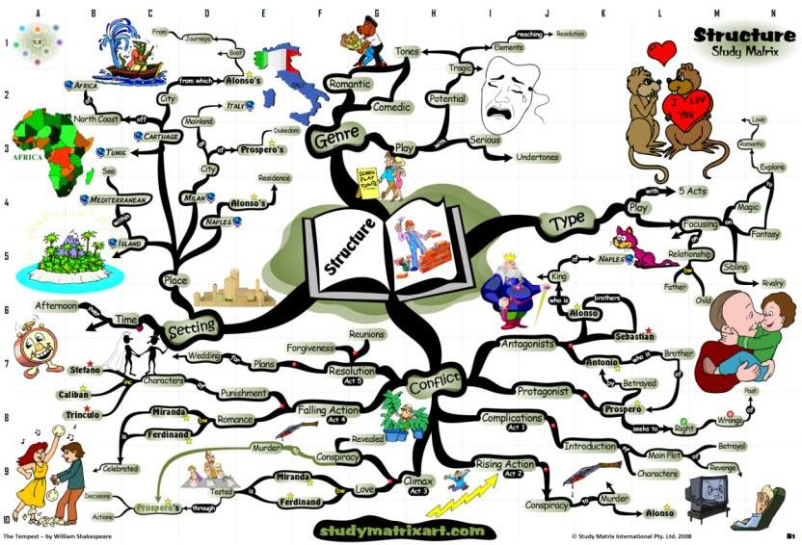
Examples of Mind Maps (2)
Source: http://mappio.com/mindmap/miwisdom/william-shakespeare-the-tempest-structure-analysis-mind-map

Slide 14
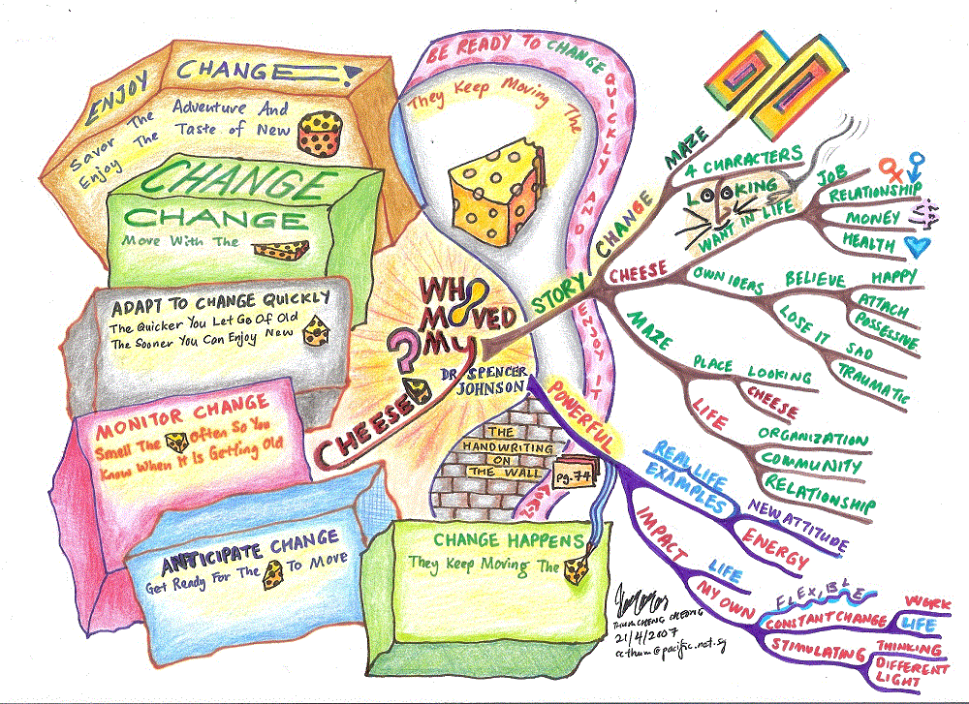
Examples of Mind Maps (3)
Source: http://www.mindmapart.com/who-moved-my-cheese-mind-map-thum-cheng-cheong/

Slide 15
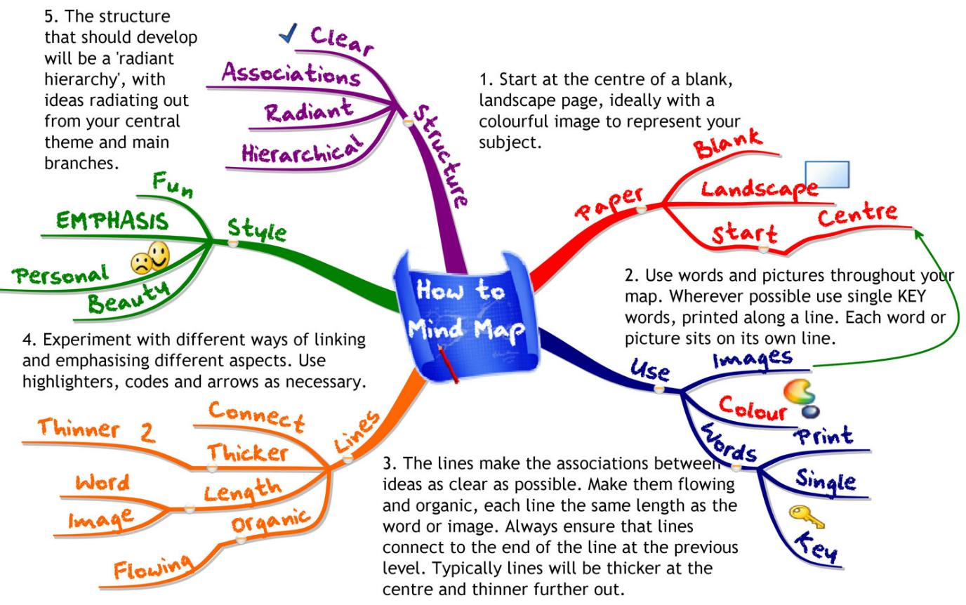
Examples of Mind Maps (4)
Source: http://www.mind-mapping.co.uk/make-mind-map.htm

Slide 16
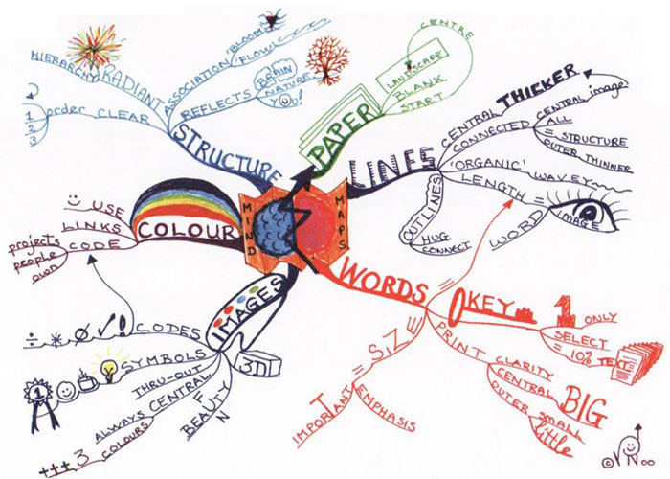
Examples of Mind Maps (5)
Source: http://litemind.com/what-is-mind-mapping/

Slide 17
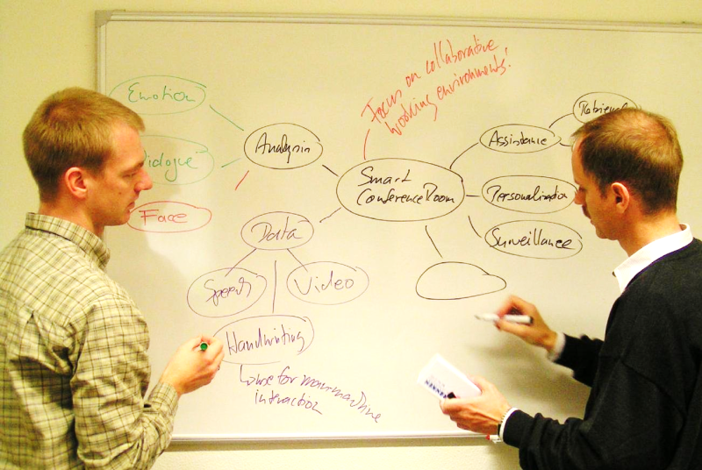
Examples of Mind Maps (6)
Source: http://patrec.cs.tu-dortmund.de/cms/en/home/Research/DAR/

Slide 18
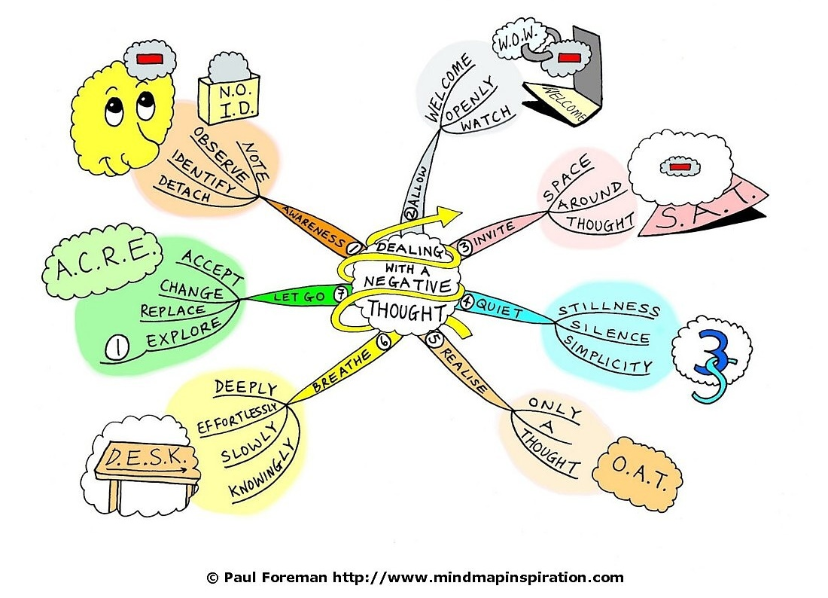
Examples of Mind Maps (7)

Slide 19
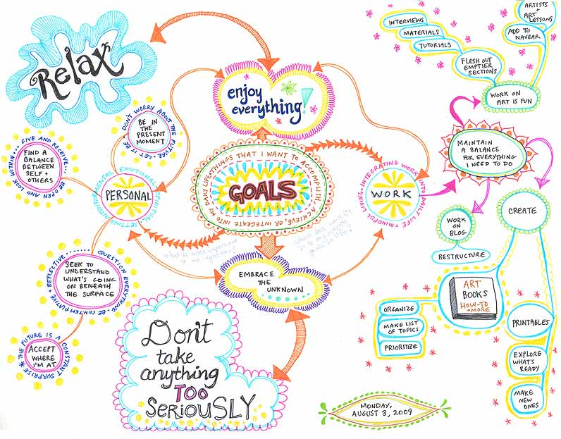
Examples of Mind Maps (8)
Source: http://www.art-is-fun.com/create-a-mind-map.html

Slide 20
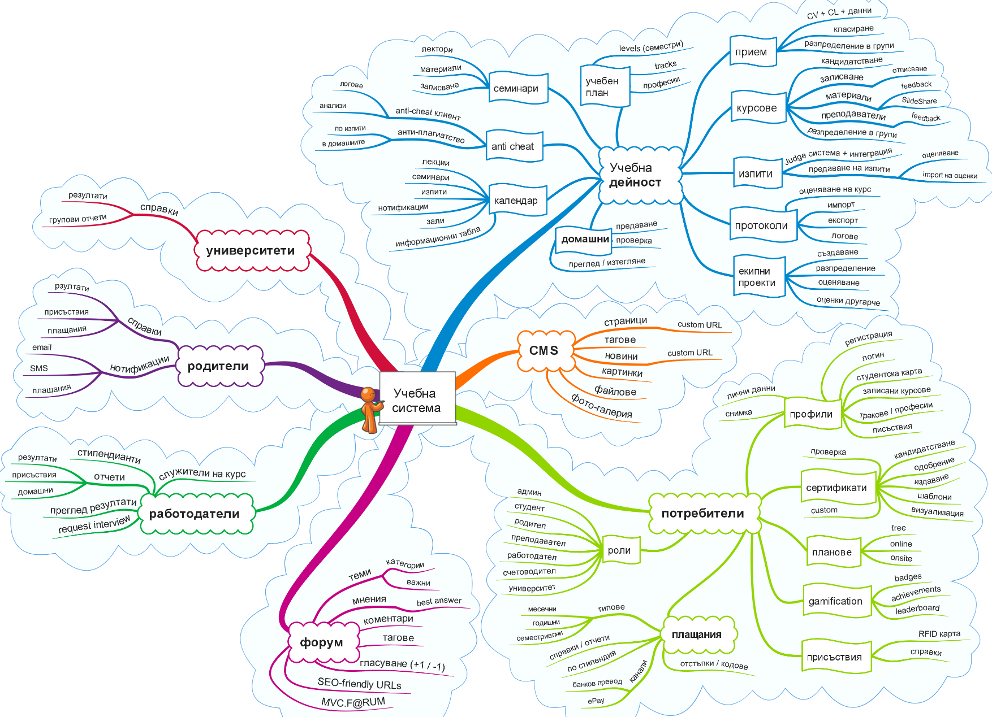
Examples of Mind Maps (9)
Source: Svetlin Nakov (Software University)

Slide 21
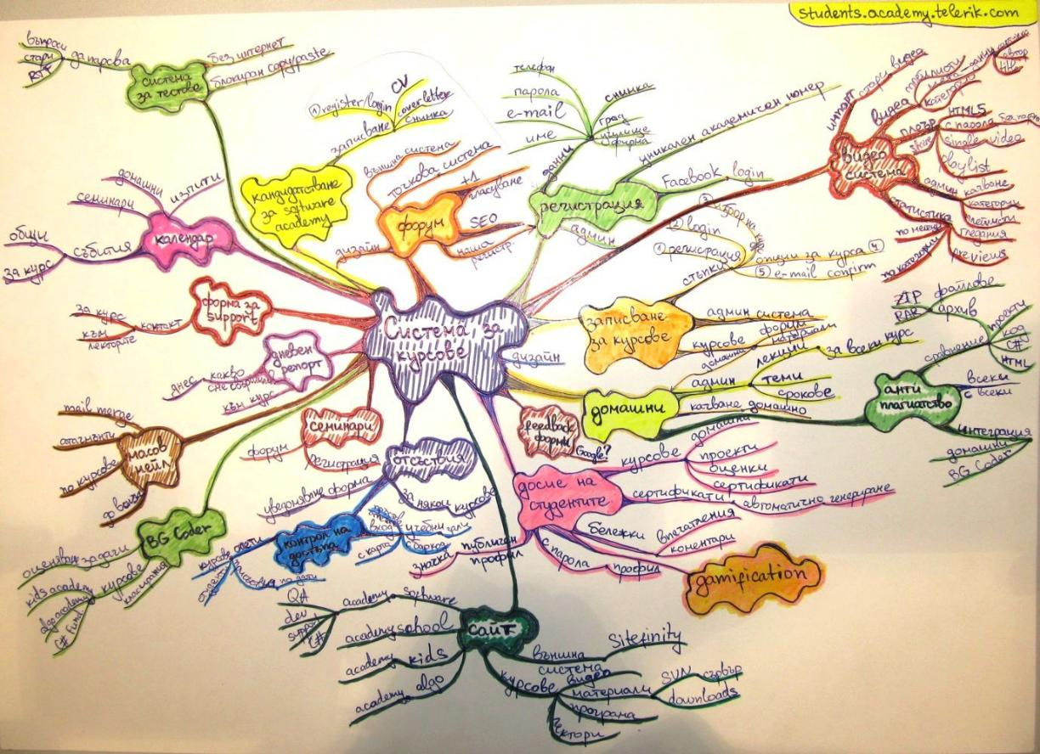
Examples of Mind Maps (10)
Source: Svetlin Nakov (Software University)

Slide 22
Examples of Mind Maps (11)
Source: Svetlin Nakov (Software University)

Slide 23
Examples of Mind Maps (12)

Slide 24
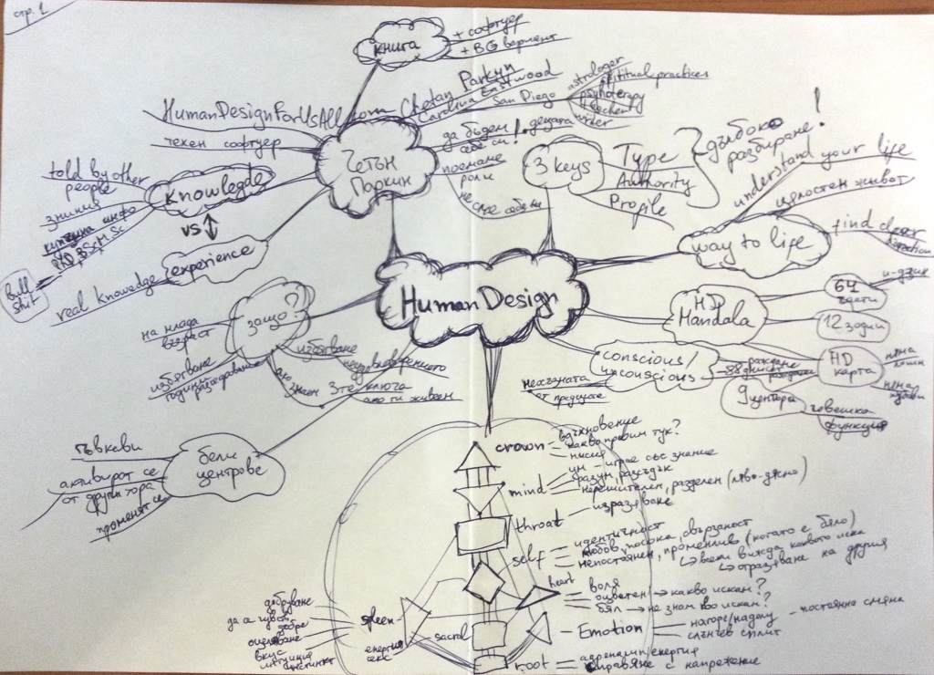
Examples of Mind Maps (13)
Source: Svetlin Nakov

Slide 25
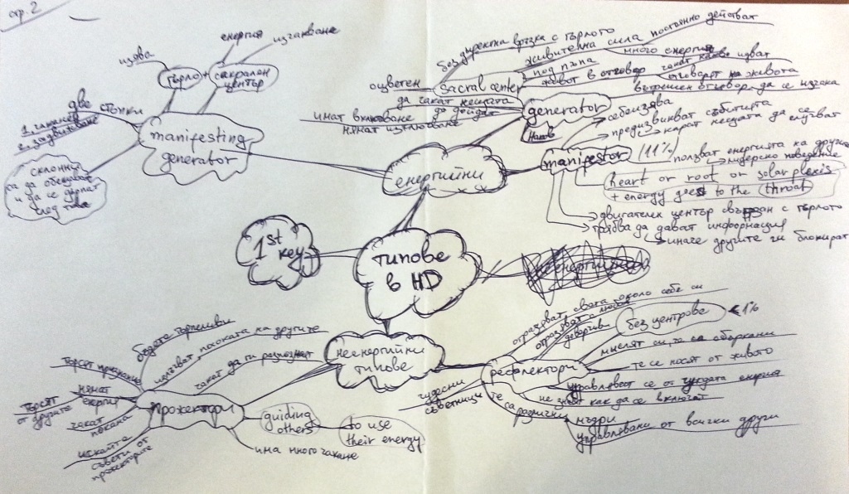
Examples of Mind Maps (14)
Source: Svetlin Nakov

Slide 26
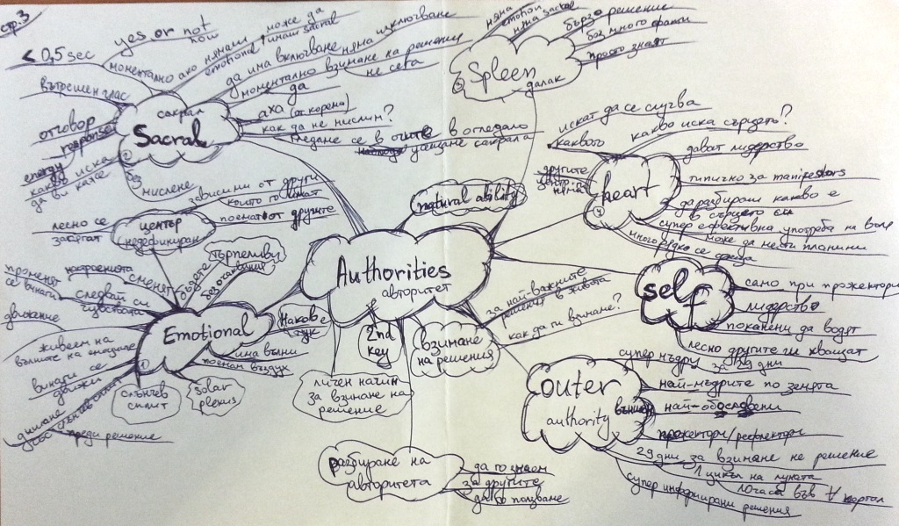
Examples of Mind Maps (15)
Source: Svetlin Nakov

Slide 27


Creating Mind Maps
Practical Guidelines

Slide 28
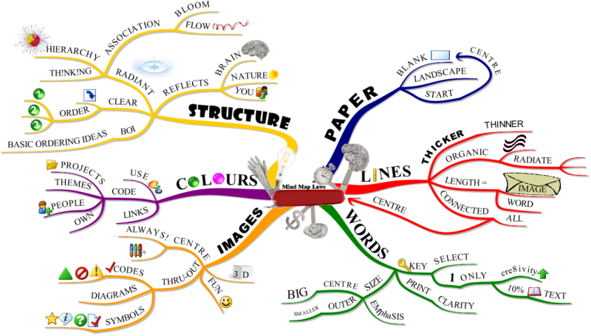
Creating Mind Maps: Steps
Source: http://buzan.com.au

Slide 29


Creating Mind Maps
Set your purpose / goal, e.g.
Plan your trip to France
Create the structure of your web site
Describe what is a "software engineer"
Take a blank sheet of paper (A4 or bigger)
Always use landscape orientation
Put your central concept (idea) in the center
Sketch an image / photo of your central idea
A picture is worth a 1000 words

Slide 30
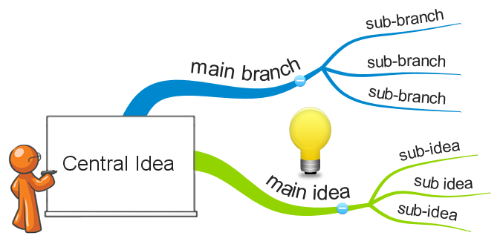
Creating Mind Maps (2)
Create your main branches
A separate branch for each association
Put a keyword / image at each branch
Create your sub-branches
Bigger branches use thicker lines
Use different colors for each branch
At least 3 colors for emphasis, structure, texture, and creativity
Use curved lines (organic lines)

Slide 31
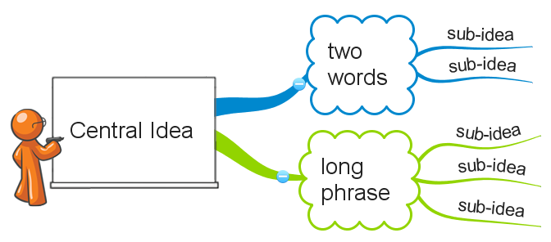
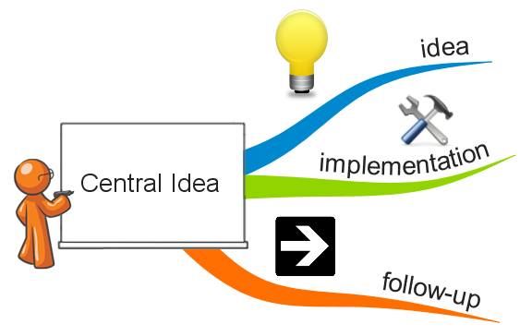
Creating Mind Maps (3)
Use a single keyword per branch
Two words → branch + sub-branch
Phrases → put into a box
Use images / symbols when possible
A picture is worth a 1000 words
Prefer uppercase letters
Easier to read and remember
Develop your personal style for mind maps
Start from the basic rules and adapt them

Slide 32


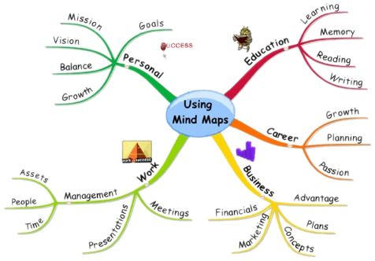
Resources
Books, Software, Etc.

Slide 33



The Mind Map Book
The Mind Map Book: How to Use Radiant Thinking to Maximize Your Brain's Untapped Potential
by Tony Buzan and Barry Buzan Dutton Adult, 1994 ISBN 9780525939047
Твоят ум може всичко
Тони Бюзан и Бари Бюзан
Софтпрес, 2010 ISBN 978-954-685-814-6

Slide 34
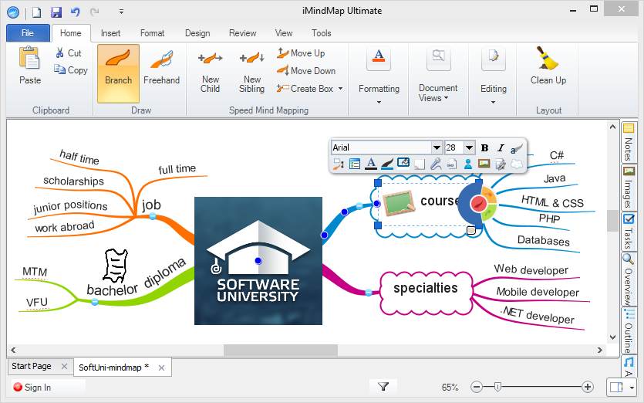
Mind Mapping Software
iMindMap
Tony Buzan' s original mind mapping software
Commercial product, has free limited version
www.thinkbuzan.com/iMindMap

Slide 35
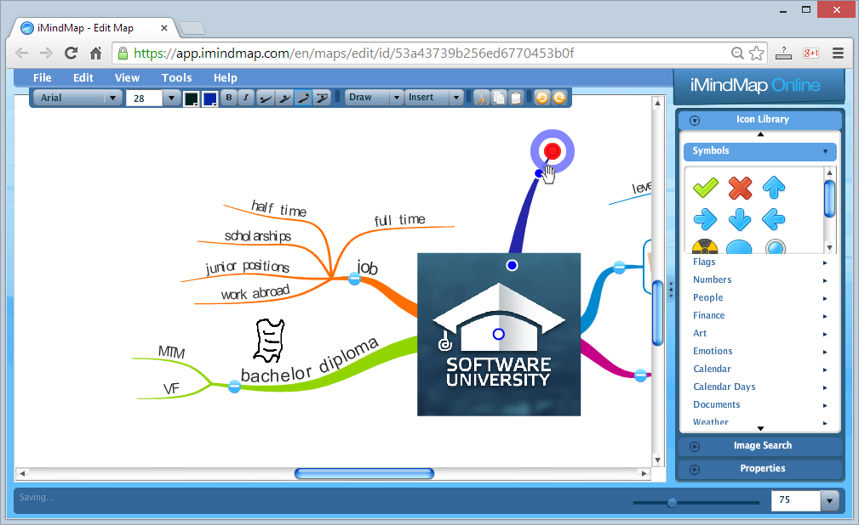
Mind Mapping Software (2)
iMindMap Cloud
Cloud-based version of iMindMap
https://app.imindmap.com

Slide 36
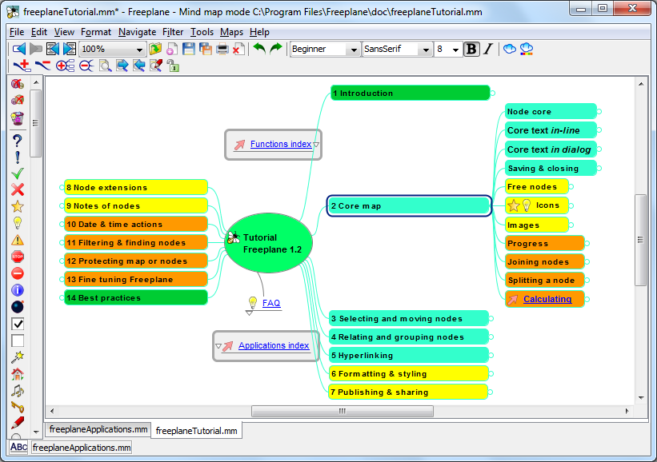
Mind Mapping Software (3)
FreePlane
Open-source mind mapping tool
http://freeplane.sourceforge.net

Slide 37
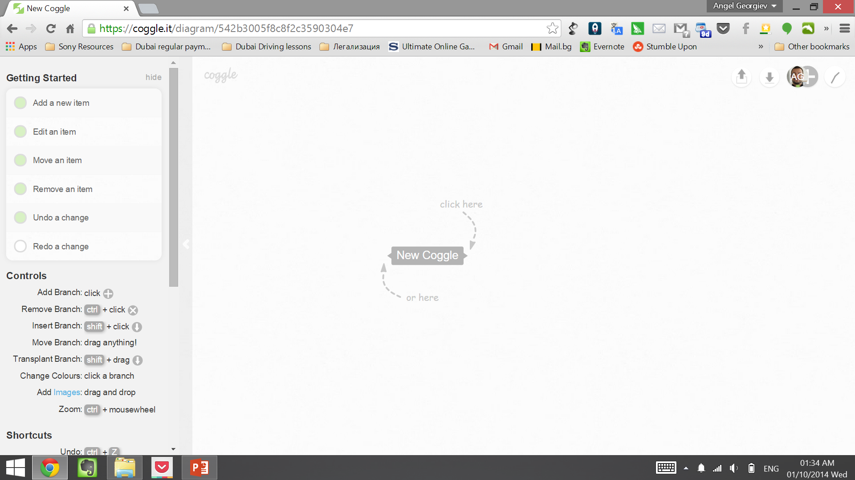
Mind Mapping Software (4)
Coggle
Online creative platform.
Collaborates with Google Drive
https://coggle.it/

Slide 38

Time for Exercises
Create a mind map of your last teamwork project
Create a mind map of your future in SoftUni
Mind map the software engineering profession
Mind map something else (by choice)

Slide 39

Application of Mind Maps
Why Do We Need Mind Mapping?

Slide 40

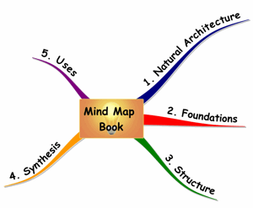
Applications of Mind Mapping
When mind mapping helps us?
Taking notes
In class when listening a lesson
In a meeting at work
When reading a book
Create a map of the book for better recall
Improved memory
Create a map of what you want to remember
Mapped content is easier to understand

Slide 41


Applications of Mind Mapping (2)
When mind mapping helps us?
Planning something
Organize your ideas into a mind map
Brainstorming
Your idea is unclear?
Try mind-mapping it!
Put everything on a sheet of paper
Creating a presentation
Put your ideas into a mind map

Slide 42










Mind Mapping
https://softuni.bg/courses/teamwork-and-personal-skills/

Slide 43
License
This course (slides, examples, demos, videos, homework, etc.) is licensed under the "Creative Commons Attribution-NonCommercial-ShareAlike 4.0 International" license
Attribution: this work may contain portions from
"Knowledge Sharing and Team Working" course by Telerik Academy under CC-BY-NC-SA license

Slide 44





Free Trainings @ Software University
Software University Foundation – softuni.org
Software University – High-Quality Education, Profession and Job for Software Developers
softuni.bg
Software University @ Facebook
facebook.com/SoftwareUniversity
Software University @ YouTube
youtube.com/SoftwareUniversity
Software University Forums – forum.softuni.bg

Slide 45



Free Trainings @ Software University
Software University Foundation – softuni.org
Software University – High-Quality Education, Profession and Job for Software Developers
softuni.bg
Software University @ Facebook
facebook.com/SoftwareUniversity
Software University @ YouTube
youtube.com/SoftwareUniversity
Software University Forums – forum.softuni.bg

